Slide 1


WE CODERS
Team Participants
Ayuska Singh Anukrati Agarwal

Slide 2
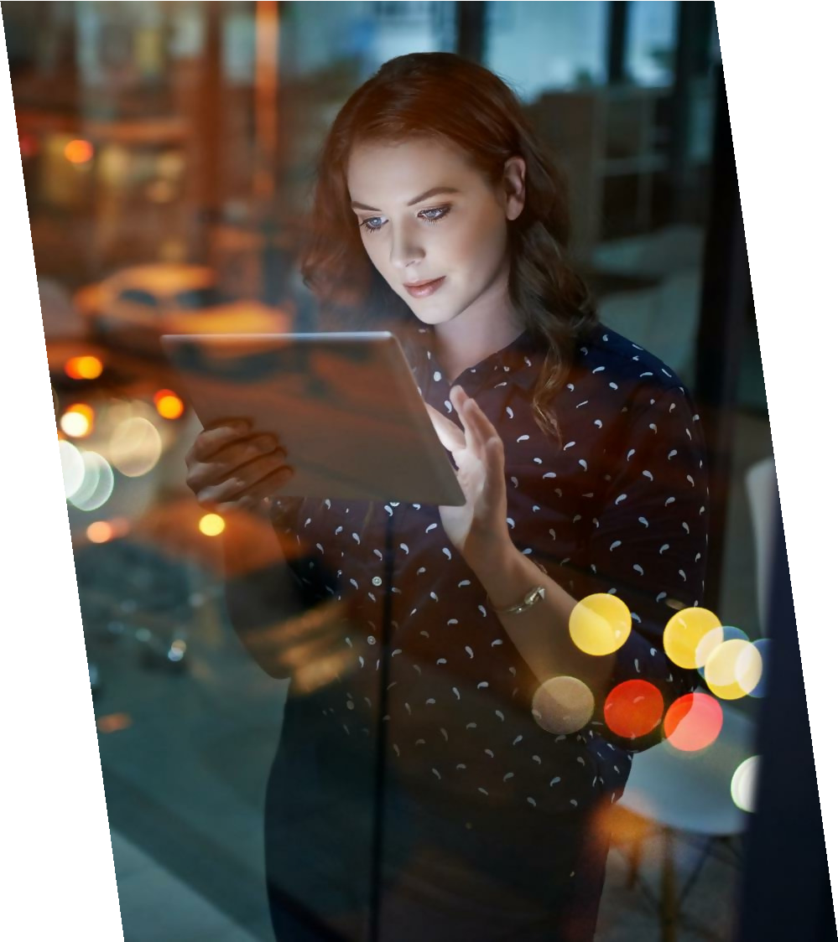
About Our Project
With the rise of fast fashion, it is difficult to keep track of ever changing trends.
A model that would help the user filter the products based on the latest trends will make
the shopping experience a lot smoother and give
Myntra an edge over other e-commerce sites.
It also analyses latest Trends using social media and would help Fashion Brands to effectively predict and produce what will be in demand, hence boosting profits along with cutting out on losses.
By helping the user make the right choice, it would2 serve as each individual’s own personal,
low budget stylist.

Slide 3
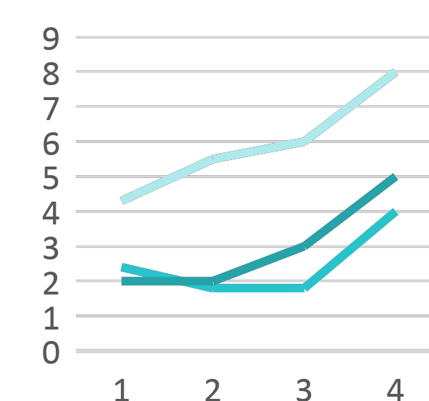
TREND DETECTION
What we did..
We took a list of Instagram influencers from a website and fed it into an open source model. Then, we had a scraper based on beautiful soup and selenium which went to each account and created a csv of links to each account, no. of followers , no. of posts and the following.
After this the model went to the profile of each influencer and made a csv of links of each individual post in the profile of that influencer.
The model in this case, a scraper went to each post and extracted information like : no. of likes, comments, date etc.
T₃his information was used to generate a set of basic features, most prominent of which were likes engagement, comments engagement and total engagement.

Slide 4
Using these basic features the model generated a list of various features to be used for modelling.
Using heat maps correlation we carried out feature selection to get the most relevant set of features to increase our accuracy.
The model used random forest regressor to predict the average engagement for the next month. Using this predicted average engagement, model calculated growth rate of the influencers.
Thus, we sorted these influencers based on growth rate and also inferred that higher the growth rate of influencers greater will be their impact on fashion trends in the market. These influencers are sent to our
4

Slide 5
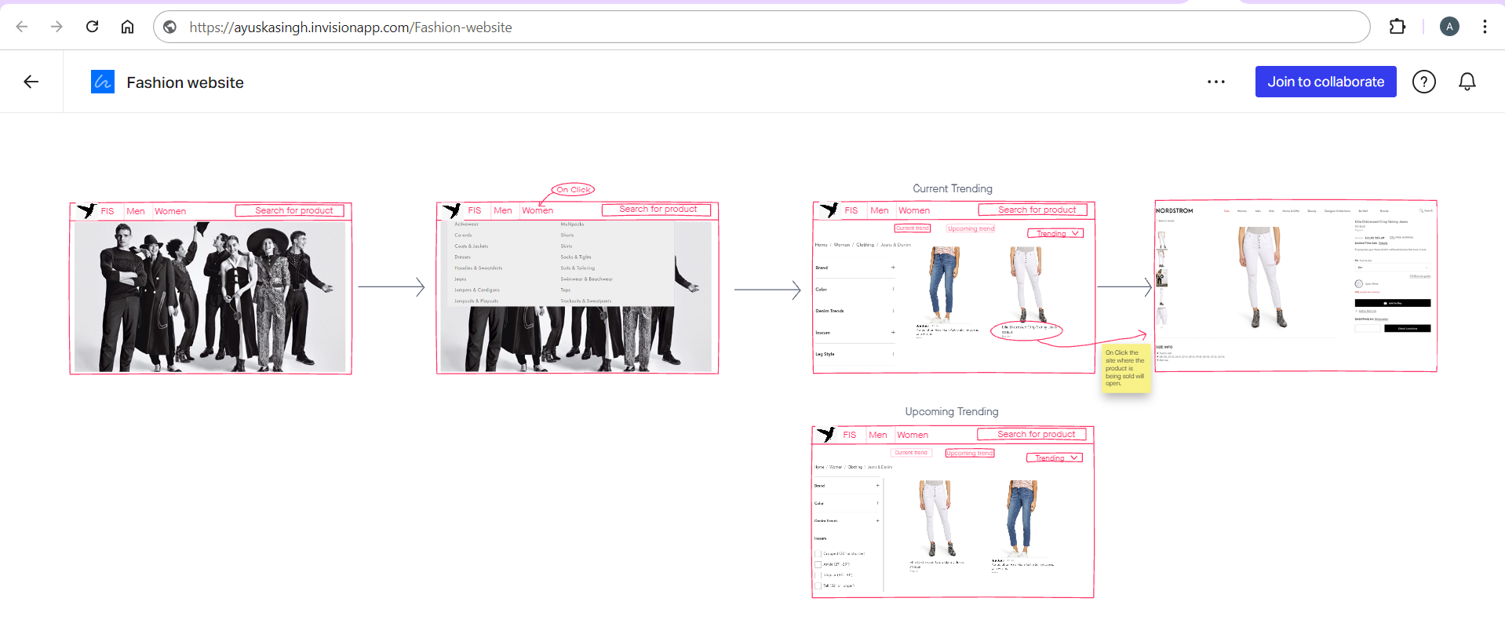

Slide 6
Model Summary and Outline
The latest fashion trends are detected from social media.
A dataset is prepared using the images obtained from the Instagram accounts of growing influencers based upon several criteria such as number of likes/comments, time of upload ( how recent it is ) etc.
The positions of functional key points defined on the clothes are predicted, such as the corners of the
•
•
neckline, hemline, and cuff.
Multi-label classification is done that aims at determining which elements of clothing are associated with attributes among a set of n attributes.
Using item retrieval from the modified dataset prepared, the model will present the user with a set of options of clothing items based on the choices selected by them.
The prototype will give an idea about the trending attributes as its output as well as present the user with outfits based on their selected choices.

